Slide 1
Tree Traversal
Course Code: 00090
Course Title: Discrete Mathematics
Dept. of Computer Science
Faculty of Science and Technology
Lecturer No: | 22 | Week No: | 13 | Semester: | Summer 21-22
Lecturer: | Md. Mahmudur Rahman (mahmudur@aiub.edu)

Slide 2
Lecture Outline
8.3 Tree Traversal
Preorder Traversal
Inorder Traversal
Postorder Traversal

Slide 3
Objectives and Outcomes
Objectives: To understand the different types of tree traversal algorithms and apply them.
Outcomes: The students are expected to be able to perform preorder, inorder and postorder tree traversal.

Slide 4
Tree Traversal
Tree traversal:
A listing of the vertices of a tree
Is a procedure that systematically visits every vertex of an ordered rooted tree

Slide 5
Traversal Algorithms
Procedures for systematically visiting every vertex of an ordered rooted tree are called traversal algorithms.
Three most commonly used traversal algorithms:
Preorder traversal
Inorder traversal
Postorder traversal

Slide 6
Preorder Traversal
DEFINITION: Let T be an ordered rooted tree with root r. If T consists only of r, then r is the preorder traversal of T . Otherwise, suppose that T₁, T₂, . . . , T_{n} are the subtrees at r from left to right in T .
The preorder traversal begins by visiting r. It continues by traversing T₁ in preorder, then T₂ in preorder, and so on, until T_{n} is traversed in preorder.
6

Slide 7
7

Slide 8
Example 2
In which order does a preorder traversal visit the vertices in the ordered rooted tree T shown in Figure 3?
Solution:
The steps of the preorder traversal of T are shown in Figure 4.
We traverse T in preorder by first listing the root a,
followed by the preorder list of the subtree with root b, the
preorder list of the subtree with root c (which is just c) and
the preorder list of the subtree with root d.
8

Slide 9
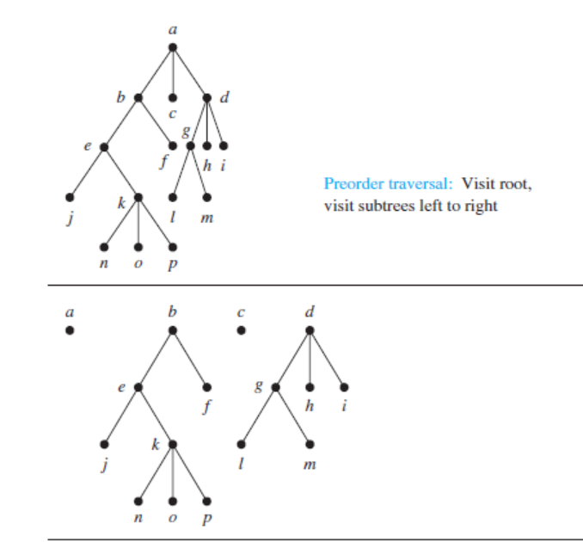
Example 2
Figure 3

Slide 10
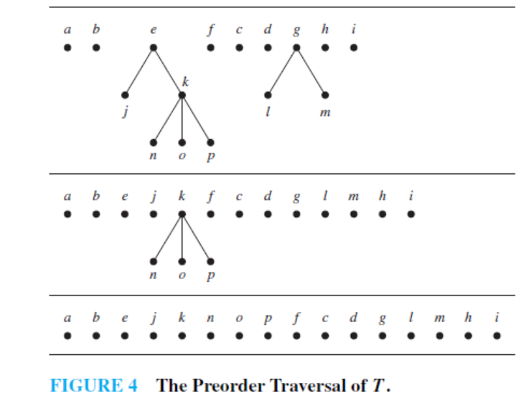
Example 2
10

Slide 11
Another Example Of Preorder Traversal
M
A
Y
E
J
R
H
P
Q
T
11

Slide 12
Another Example Of Preorder Traversal
M
A
Y
E
J
R
H
P
Q
T
M
A
J
Y
R
H
P
Q
T
E
12

Slide 13
Inorder Traversal
DEFINITION 2: Let T be an ordered rooted tree with root r. If T consists only of r, then r is the inorder traversal of T. Otherwise, suppose that T₁, T₂, . . . , T_{n} are the subtrees at r from left to right.
The inorder traversal begins by traversing T₁ in inorder, then visiting r. It continues by traversing T₂ in inorder, then T₃ in inorder,..., and ﬁnally T_{n} in inorder.

Slide 14
Inorder Traversal
Step 1: Visit T₁ in inorder
Step 2: Visit the root r
r
Step 3: Visit T₂ in inorder
Step n+1: Visit T_{n} in inorder
T₁
T₂
T_{n}
14
14

Slide 15
15
15

Slide 16
Example Inorder Traversal
EXAMPLE 3: In which order does an inorder traversal visit the vertices of the ordered rooted tree T in Figure 3?
Solution: The steps of the inorder traversal of the ordered
rooted tree T are shown in Figure 6. The inorder traversal
begins with an inorder traversal of the subtree with root b,
the root a, the inorder listing of the subtree with root c,
which is just c, and the inorder listing of the subtree with
root d.
16
16

Slide 17
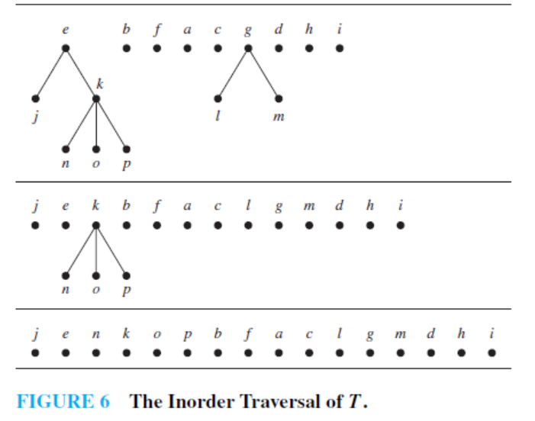
Example of Inorder Traversal
Figure 3
17
17

Slide 18
Postorder Traversal
DEFINITION 3: Let T be an ordered rooted tree with root r. If T consists only of r, then r is the postorder traversal of T . Otherwise, suppose that T₁, T₂, . . . , T_{n} are the subtrees at r from left to right.
The postorder traversal begins by traversing T₁ in postorder, then T₂ in postorder, . . . , then T_{n} in postorder, and ends by visiting r.
18
18

Slide 19
Postorder Traversal
Step 1: Visit T₁ in postorder
Step 2: Visit T₂ in postorder
r
Step n: Visit T_{n} in postorder
Step n+1: Visit r
T₁
T₂
T_{n}

Slide 20
Example 4
EXAMPLE 4 : In which order does a postorder traversal visit the vertices of the ordered rooted tree T shown in Figure 3?
Solution: The steps of the postorder traversal of the ordered rooted tree T are shown in Figure 8. The postorder traversal
begins with the postorder traversal of the subtree with
root b, the postorder traversal of the subtree with root c,
which is just c, the postorder traversal of the subtree with
root d, followed by the root a.

Slide 21
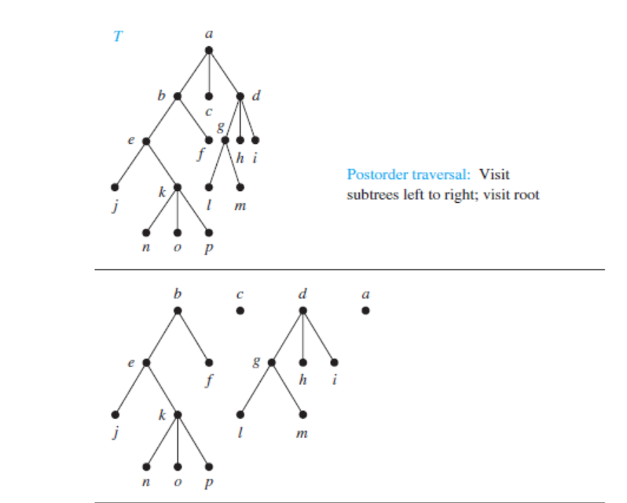
Figure 3

Slide 22
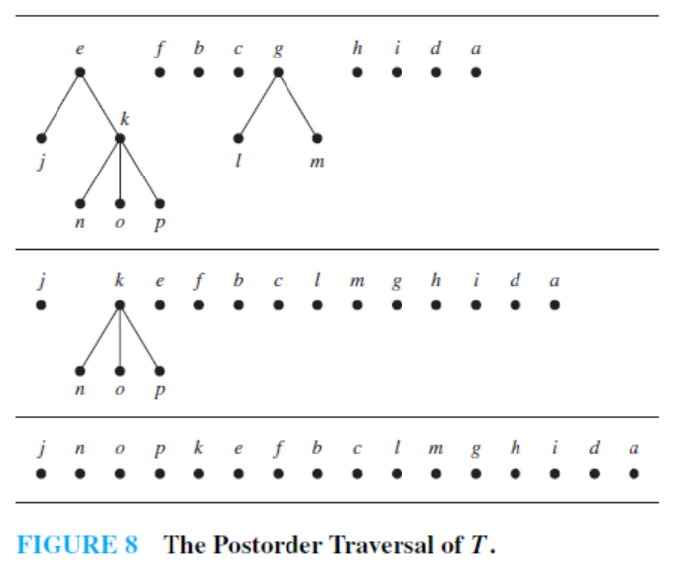
Example 4

Slide 23
Class Work
Determine the order in which a (a) Preorder, (b) Inorder, and
(c) Postorder traversal visits the vertices of the ordered rooted tree below.
a
d
b
c
e
g
i
f
h
k
j
l
m
n
o
p

Slide 24
Answers
Preorder: a b e j k n o p f c d g l m h i
Inorder: j e n k o p b f a c l g m d h i
Postorder: j n o p k e f b c l m g h i d a

Slide 25
Books
Rosen, K. H., & Krithivasan, K. (2012). Discrete mathematics and its applications: with combinatorics and graph theory. Tata McGraw-Hill Education. (7th Edition)

Slide 26
References
Discrete Mathematics, Richard Johnsonbaugh, Pearson education, Inc.
Discrete Mathematical Structures, Bernard Kolman, Robert C. Busby, Sharon Ross, Prentice-Hall, Inc.
SCHAUM’S outlines Discrete Mathematics(2nd edition), by Seymour Lipschutz, Marc Lipson
University of Hawaii
http://courses.ics.hawaii.edu/ReviewICS241/morea/trees/TreeTraversal-QA.pdf
Florida State University
http://www.cs.fsu.edu/~lacher/lectures/Output/trees_intro/script.html

